Slide 1
Structural Change and Aggregate Employment Fluctuations in China and the US
Fin 500R Presentation
Wesley Chen
Oct 3 2019

Slide 2
Observation
The correlation between aggregate employment and GDP is highly positive in the US, but close to zero in China.
The difference in the size of the agricultural sector is the reason for the difference in employment-output correlation
Argument

Slide 3
Facts
China had around 70% share of total employment in agriculture industry back in 80s, and still around 25% until 2010
US only has less than 3% employed population working in agriculture sector constantly

Slide 4
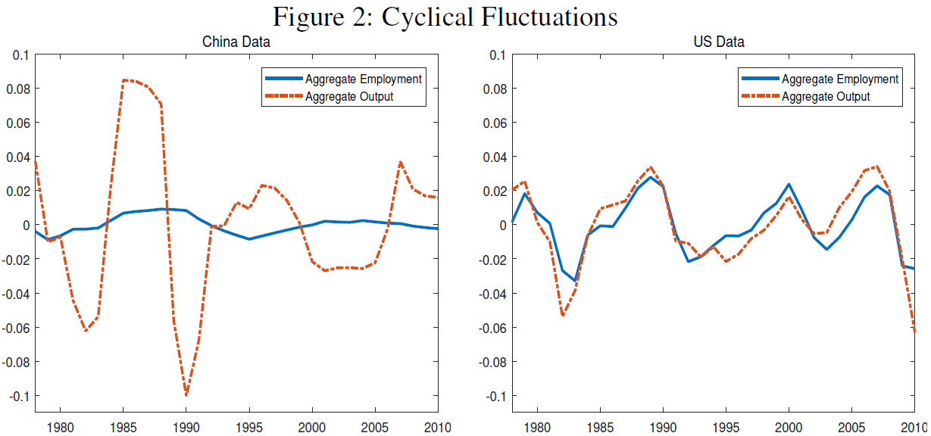
Employment Fluctuation – Aggregate Level
The magnitude of fluctuations in the aggregate employment is much lower than that of the aggregate output in China, while the US has the opposite result
Aggregate employment is not cyclical in China because the correlation of the aggregate employment and output is close to zero
σ (L) – std of aggregate employment (Labor)
σ (Y) – std of output (GDP)
ρ (L, Y) – Correlation of the two

Slide 5
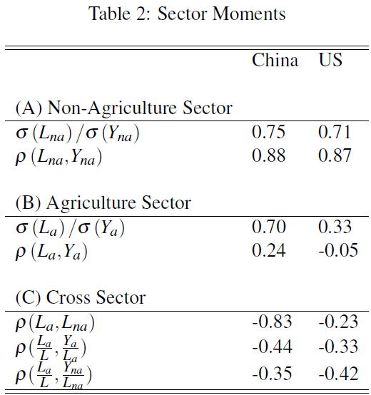
Employment Fluctuation – Industry Level
Employment fluctuations at the sector level are very similar between China and the US
The correlation between the employments in the two sectors is negative in both China and the US - labor reallocation between the two sectors could have an important dampening effect on the aggregate employment fluctuations in China, but because of the small size of the agriculture industry in the US, the effect is negligible
For both China and the US, the agriculture’s share of total employment is negatively correlated with labor productivities (measured as GDP per worker) in both the agricultural and non-agricultural sectors
Results highly suggest that income effect, that is, the agricultural good has lower income elasticity than the non-agricultural good, is an important factor for labor reallocation between sectors
L – employment in corresponding industry
Y – output in corresponding industry
Panel (C) shows the correlation of the cyclical employments in the two sectors and the correlations between the agriculture’s share of employment and the real GDP per worker in the two sectors.

Slide 6
The Model
Motivated by these facts, I now present the two-sector model with non-homothetic preferences that we will use to quantitatively account for labor market dynamics in both the long-run and short-run.
Utility function for preference over a composite consumption good Ct and working time Lt
λ and σ are both non-negative numbers representing the inverses of the elasticity of intertemporal substitution and the Frisch labor supply elasticity, respectively
Bt > 0 is a time-varying labor supply parameter that is used to capture the demographic factors
φ represents the household’s preference weight on consumption good in sector i (φ(a)+ φ(na) = 1)
μ is a parameter that determines the income elasticity of consumption good i
ε is the elasticity of substitution between the two consumption goods
c(it) is the consumption of two goods, a and na
A is the productivity
L is the employment in the corresponding industry
Subject to the following constraints:

Slide 7
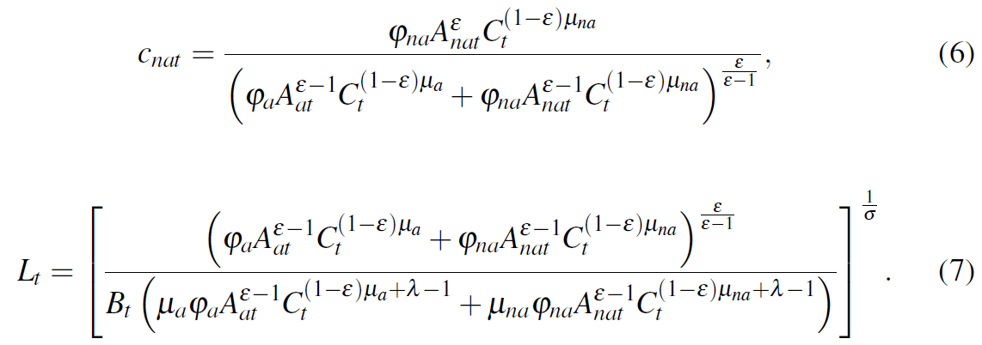
The Model
The optimal consumption of the two goods, c(at) and c(nat) , and the aggregate employment rate Lt satisfy the following equations:
λ and σ are both non-negative numbers representing the inverses of the elasticity of intertemporal substitution and the Frisch labor supply elasticity, respectively
Bt > 0 is a time-varying labor supply parameter that is used to capture the demographic factors
φ represents the household’s preference weight on consumption good in sector i (φ(a)+ φ(na) = 1)
μ is a parameter that determines the income elasticity of consumption good i
ε is the elasticity of substitution between the two consumption goods
c(it) is the consumption of two goods, a and na
A is the productivity
L is the employment in the corresponding industry

Slide 8
The Model
From the goods market clearing conditions, equation (2), (3), (5) and (6), we have
The agriculture’s share of employment is affected by two factors:
The relative productivity of agriculture A(at) / A(nat), substitution effect
The aggregate consumption per capita Ct, income effect
The substitution effect depends on whether ε is smaller or larger than one. If ε < 1, the agriculture’s share of employment is a decreasing function of the agricultural sector’s productivity and an increasing function of the non-agricultural sector’s productivity. The opposite is true if ε > 1
The cyclical component of the agriculture’s share of employment is negatively correlated with the cyclical components of real labor productivities in both sectors, suggesting that the second factor, income effect, is also important for labor reallocation. If μ(a) < μ(na), then the agriculture’s share of employment is a decreasing function of the aggregate consumption. In this case, since labor productivities in both sectors have positive impact on the aggregate consumption, they both have a negative effect on the agriculture’s share of employment
Hence the aggregate employment to population ratio is
And the sector employment shares are
λ and σ are both non-negative numbers representing the inverses of the elasticity of intertemporal substitution and the Frisch labor supply elasticity, respectively
Bt > 0 is a time-varying labor supply parameter that is used to capture the demographic factors
φ represents the household’s preference weight on consumption good in sector i (φ(a)+ φ(na) = 1)
μ is a parameter that determines the income elasticity of consumption good i
ε is the elasticity of substitution between the two consumption goods
c(it) is the consumption of two goods, a and na
A is the productivity
L is the employment in the corresponding industry

Slide 9
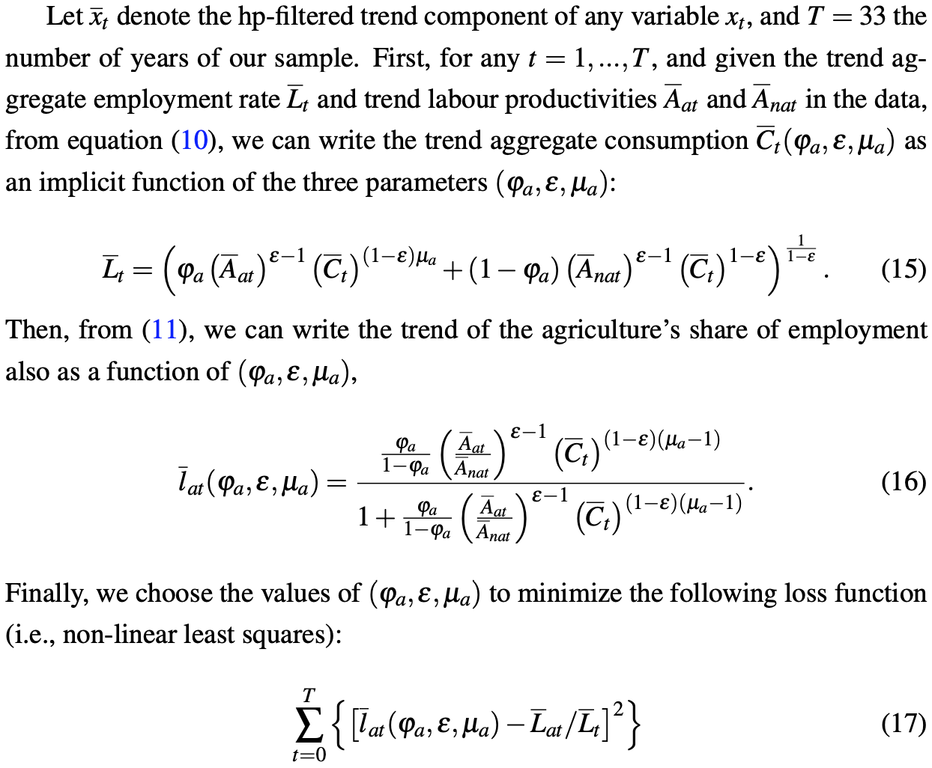
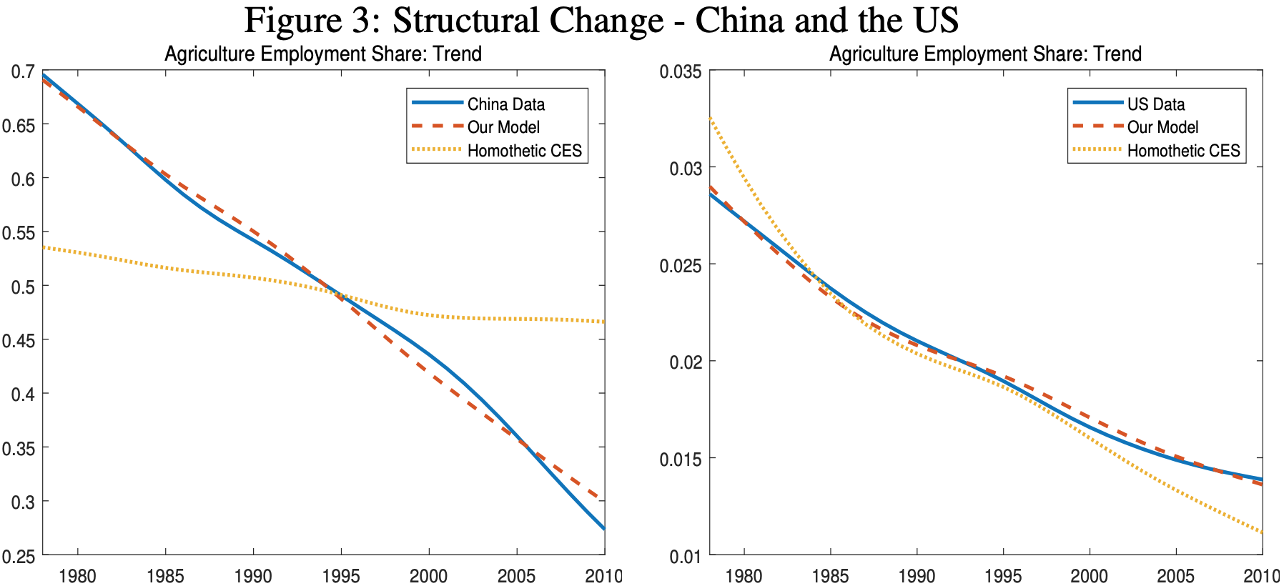
Structural Change – Long-run Labor Reallocation
Since the agriculture’s share of employment is invariant with respect to the scale of the two income elasticity parameters , µa and µna, we normalize the scale of the two parameters by setting µ(na) to 1.
Next, all we need is to calibrate, φ, ε and μ
Results for China: ϕa = 0.3605, ε = 0.4754, and µa = 0.1970
Results for the US: ϕa = 0.0772, ε = 0.4754, and µa = 0.1970
λ and σ are both non-negative numbers representing the inverses of the elasticity of intertemporal substitution and the Frisch labor supply elasticity, respectively
Bt > 0 is a time-varying labor supply parameter that is used to capture the demographic factors
φ represents the household’s preference weight on consumption good in sector i (φ(a)+ φ(na) = 1)
μ is a parameter that determines the income elasticity of consumption good i
ε is the elasticity of substitution between the two consumption goods
c(it) is the consumption of two goods, a and na
A is the productivity
L is the employment in the corresponding industry

Slide 10
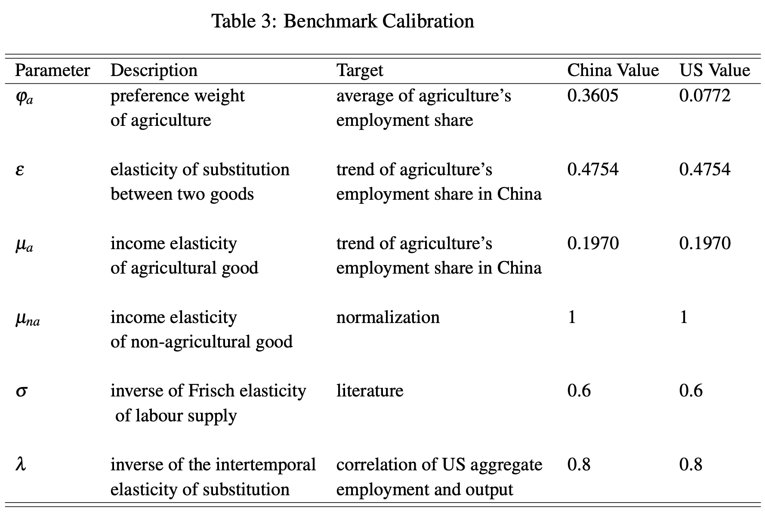
Short-run Labor Reallocation and Aggregate Employment Fluctuations
Since our objective here is to investigate our model’s implication for aggregate employment fluctuations, we can no longer assume that the aggregate employment rate is exogenously given. Instead, we have to solve Lt endogenously from the model. This implies that we need to solve the aggregate consumption Ct from equation (14), which requires the values of the parameters λ and σ as well as the previously calibrated values of (ϕa, ε,µa). we choose the labor supply parameter Bt to solve the following equation:
where Lt , Aat and Anat are the trends of the aggregate employment rate, the labor productivity in the agricultural and non-agricultural sectors, respectively, and Ct is the trend aggregate consumption solved from equation (15)
λ and σ are both non-negative numbers representing the inverses of the elasticity of intertemporal substitution and the Frisch labor supply elasticity, respectively
Bt > 0 is a time-varying labor supply parameter that is used to capture the demographic factors
φ represents the household’s preference weight on consumption good in sector i (φ(a)+ φ(na) = 1)
μ is a parameter that determines the income elasticity of consumption good i
ε is the elasticity of substitution between the two consumption goods
c(it) is the consumption of two goods, a and na
A is the productivity
L is the employment in the corresponding industry
We set σ = 0.6 so that the Frisch elasticity of labor supply is 1.7, and a value of 0.8 for the parameter λ.
They are widely used coefficients in literature

Slide 11
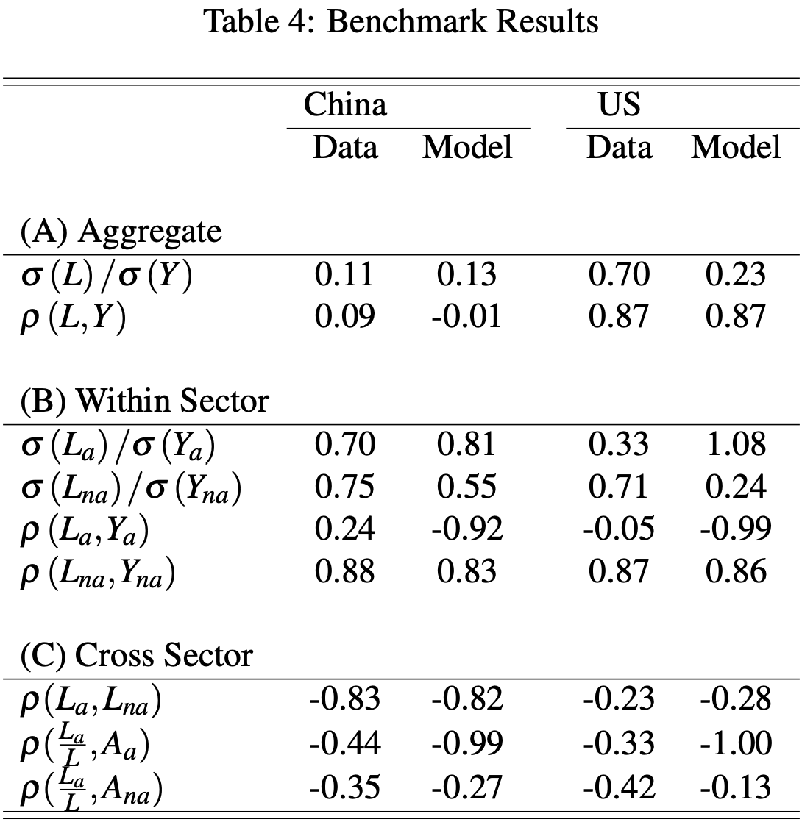
Results
The model matches well with our observation:
Aggregate employment in China is not correlated with output while in the US they are highly correlated
In Panel B, relative employment volatilities in the two sectors that are comparable to those in the data
Agriculture sector has employment and output negatively correlated
Panel C indicates strong reallocation between the two sectors
Strong substitution effect and income effect leads to a decrease share of employment in agriculture sector as productivity in both sector increases

Slide 12
Thank you.

